Slide 1


Final Year Project
FITNESSSTAN
Supervised By: Muhammad Islam (Lecturer)

Slide 2
Project Team
Obaid-Ullah(35739)
Zain Ul Abideen (35515)
Huzaifa khan (35726)

Slide 3
Table of Content
Background and Introduction
Literature Review
Problem Statement
Proposed Solution
Requirements Summary
Design Summary
Methodology
Implementation Summary
Experiments and Results Summary
Testing Summary

Slide 4
BACKGROUND AND INTRODUCTION

Slide 5
Background and Introduction[1/2]
What Is Fitness?
Fitness is a state of health and well-being that allows a person to perform daily activities with vigor, alertness, and minimal fatigue.[1]
What is Diet?
A diet is a specific selection of food and drink designed to meet health or fitness goals. It is often short-term and tailored to address immediate needs like weight loss or muscle gain.[1]
[1] https://en.wikipedia.org/wiki/Physical_fitness

Slide 6
Background and Introduction[2/2]
Fitnessstan is an AI-powered web platform that provides personalized fitness solutions for health-conscious individuals, including those managing conditions like obesity. By integrating tailored workout and diet recommendations, the platform ensures a balanced and comprehensive approach to achieving fitness goals. Its user-friendly design and accessibility aim to make fitness achievable for everyone.

Slide 7
Literature Review

Slide 8
Literature Review [1/6]
There's been a substantial increase in the usage of fitness platforms using AI, with an annual growth rate of 17%. [1]
Importance of Nutrition in Fitness:
Studies suggest that a balanced intake of carbohydrates, proteins, and fats is crucial for optimizing workout results [2] [3]
Combining a structured workout plan with a tailored diet plan can lead to better fitness outcomes.
[1] https://www.solutelabs.com/blog/future-of-fitness
[2] https://www.healthline.com/nutrition/workout-routine-for-men
[3] https://www.puregym.com/blog/the-best-gym-workout-plan-for-gaining-muscle/

Slide 9
Literature Review [2/6]
Resting Energy Expenditure (REE) [1]
It represents the energy required by the body to maintain essential physiological functions while at rest.
These equations typically consider factors such as weight, height, age, and gender.
The Mifflin-St Jeor equation for males is: [1]
REE=10×weight kg +6.25×height cm −5×age y +5
The Mifflin-St Jeor equation for females is: [1]
REE=10×weight kg +6.25×height cm −5×age y −161
[1] https://pubmed.ncbi.nlm.nih.gov/2305711/

Slide 10
Literature Review [3/6]
Total Daily Energy Expenditure (TDEE) [1]
the total number of calories that your body burns in a day, encompassing all activities and physiological functions
TDEE is crucial for weight management [1]
Sedentary (little or no exercise): REE × 1.2
Lightly active (sports 1-3 days/week): REE × 1.375
Moderately active (sports 3-5 days/week): REE × 1.55
Very active (sports 6-7 days a week): REE × 1.725
Extra active (very hard exercise, training twice a day): REE × 1.9
[1] https://pubmed.ncbi.nlm.nih.gov/16020440/

Slide 11
Literature Review [4/6]
Weight loss [1]
At moderate Pace: Calories Intake=TDEE−500
At faster Pace: Calories Intake=TDEE−1000
Weight Gain [1]
At moderate Pace: Calories Intake=TDEE+500
At faster Pace: Calories Intake=TDEE+1000
Maintenance [1]
Calories Intake=TDEE
[1] https://pubmed.ncbi.nlm.nih.gov/16020440/

Slide 12
Literature Review [5/6]
No. | Name, Reference | Inventor/Authors | Year | Input | Output | Description
1 | Diet Recommendation System Using Machine Learning | Reema Golagana, V. Sravani, T. Mohan Reddy, CH Kavitha | 2023 | User data (BMI, preferences) | Giving diet plans | Uses Random Forest, K-Means, and LSTM for generating tailored diet recommendations.
2 | Multi-Choice Diet Recommendation Application for Indian Scenario | Karthika Subbaraj | 2024 | BMI, TDEE, and Indian food dataset | Calorie-specific meal plans | Utilizes Random Forest for meal classification and KNN for alternative suggestions, achieving 91% accuracy.

Slide 13
Literature Review [6/6]
3 | A Hybrid Healthy Diet Recommender System | Sara Sweidan, S.S. Askar, Mohamed Abouhawwash, Elsayed Badr | 2024 | Anthropometric and clinical measurements | Calorie and nutrient estimations | Combines SVR, LR, and DTR models to generate calorie estimates with R=0.985 for obesity treatment.
4 | Personalized Diet Recommendation System Using Machine Learning | D. Navya Narayana Kumari, T. Praveen Satya, B. Manikanta, et al. | Not specified | User preferences | Meal recommendations and preparation details | Employs Nearest Neighbors with cosine similarity for content-based filtering tailored to user preferences.

Slide 14
PROBLEM STATEMENT

Slide 15
Problem Statement
Obesity individuals face significant challenges in maintaining their diet effectively. Existing platform only focus on exercise and struggles in giving personalized diet plan. Existing platform do not recommend diet along with exercises If they do they bound people with specific food item, which is difficult for people to have on regular basis. They do not provide personalized diet plans according to user needs.

Slide 16
Requirement and Design Summary

Slide 17
Requirements Summary
User Functional requirement:
In our system the user have Nine functional requirements.
Admin Functional requirement:
In our system the user have Nine functional requirements.

Slide 18
Design Summary
We implement the following diagrams in Design.
User Case Diagram
System Architecture Diagram
Methodology Diagram
Proposed Model Diagram
Database schema Diagram

Slide 19
Methodology And Proposed Solution

Slide 20
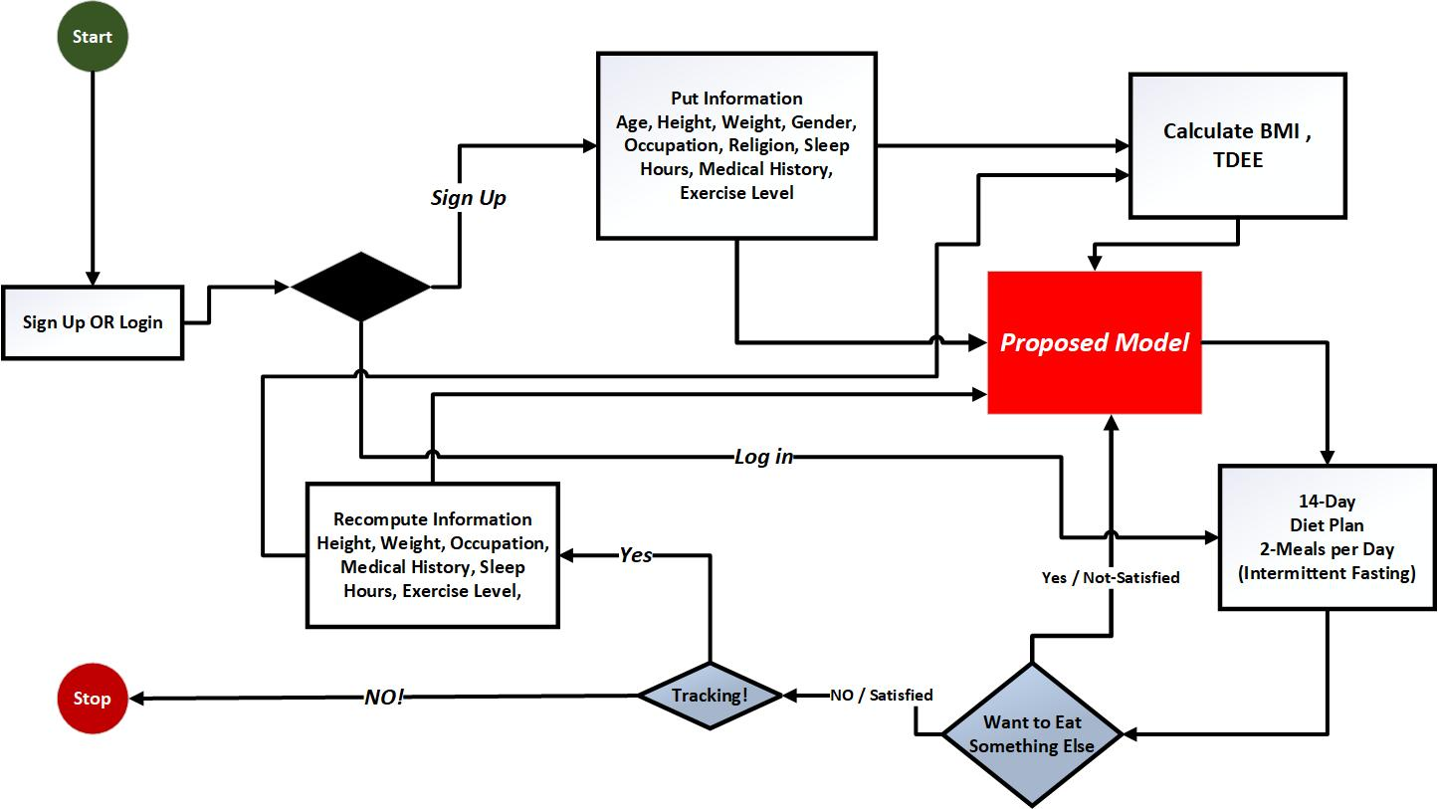
Methodology

Slide 21
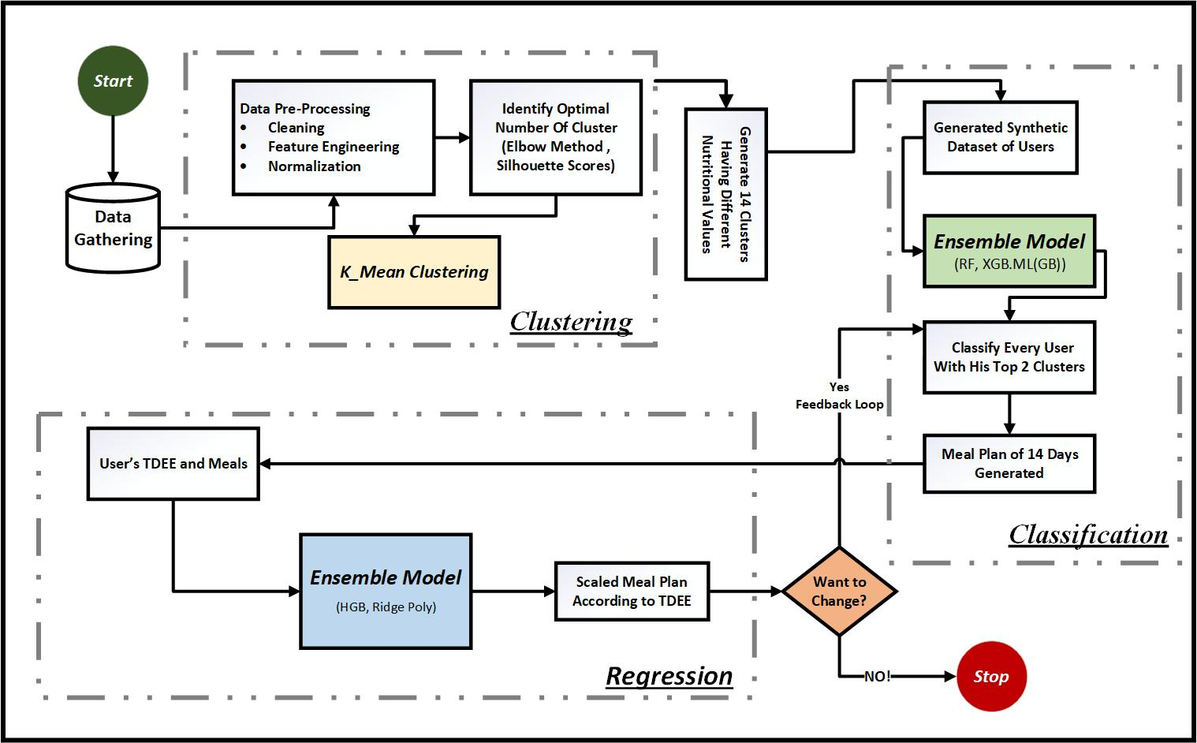
Proposed Solution

Slide 22
Implementation Summary

Slide 23
Implementation [1/4]
List Development Tools & Technologies
Frontend: React.js (for a responsive and dynamic user interface).
Backend: Spring Boot(for creating RESTful APIs).
Database: MongoDB (for secure and efficient data storage).
Programming Languages: Python, JavaScript, Java (for backend and frontend development).
Version Control: GitHub (for collaboration version control and automation).

Slide 24
Implementation [2/4]
List of Libraries / Components / Web Services
Frontend:
React Bootstrap
React Router
React icons/Fa
uiverse.io for innovative designs
Axios

Slide 25
Implementation [3/4]
List of Libraries / Components / Web Services
Backend:
spring security
bcrypt password
CRUD APIs
Annotations
Lombok
SMTP
MongoDB
OTP Store

Slide 26
Implementation [4/4]
List of Libraries
Machine Learning Libraries:
- pandas, numpy
- scikit-learn
- matplotlib.pyplot
- pickle

Slide 27
Experiments and Results Summary

Slide 28
Experiments and Results Summary[1/7]
In our proposed model there are three phases: Clustering, Classification and Regression
Clustering
Dataset: Nutrition dataset source from kaggle which contains 8789 instances and 79 features.
Data Pre-processing: Normalization , feature engineering and cleaning.

Slide 29
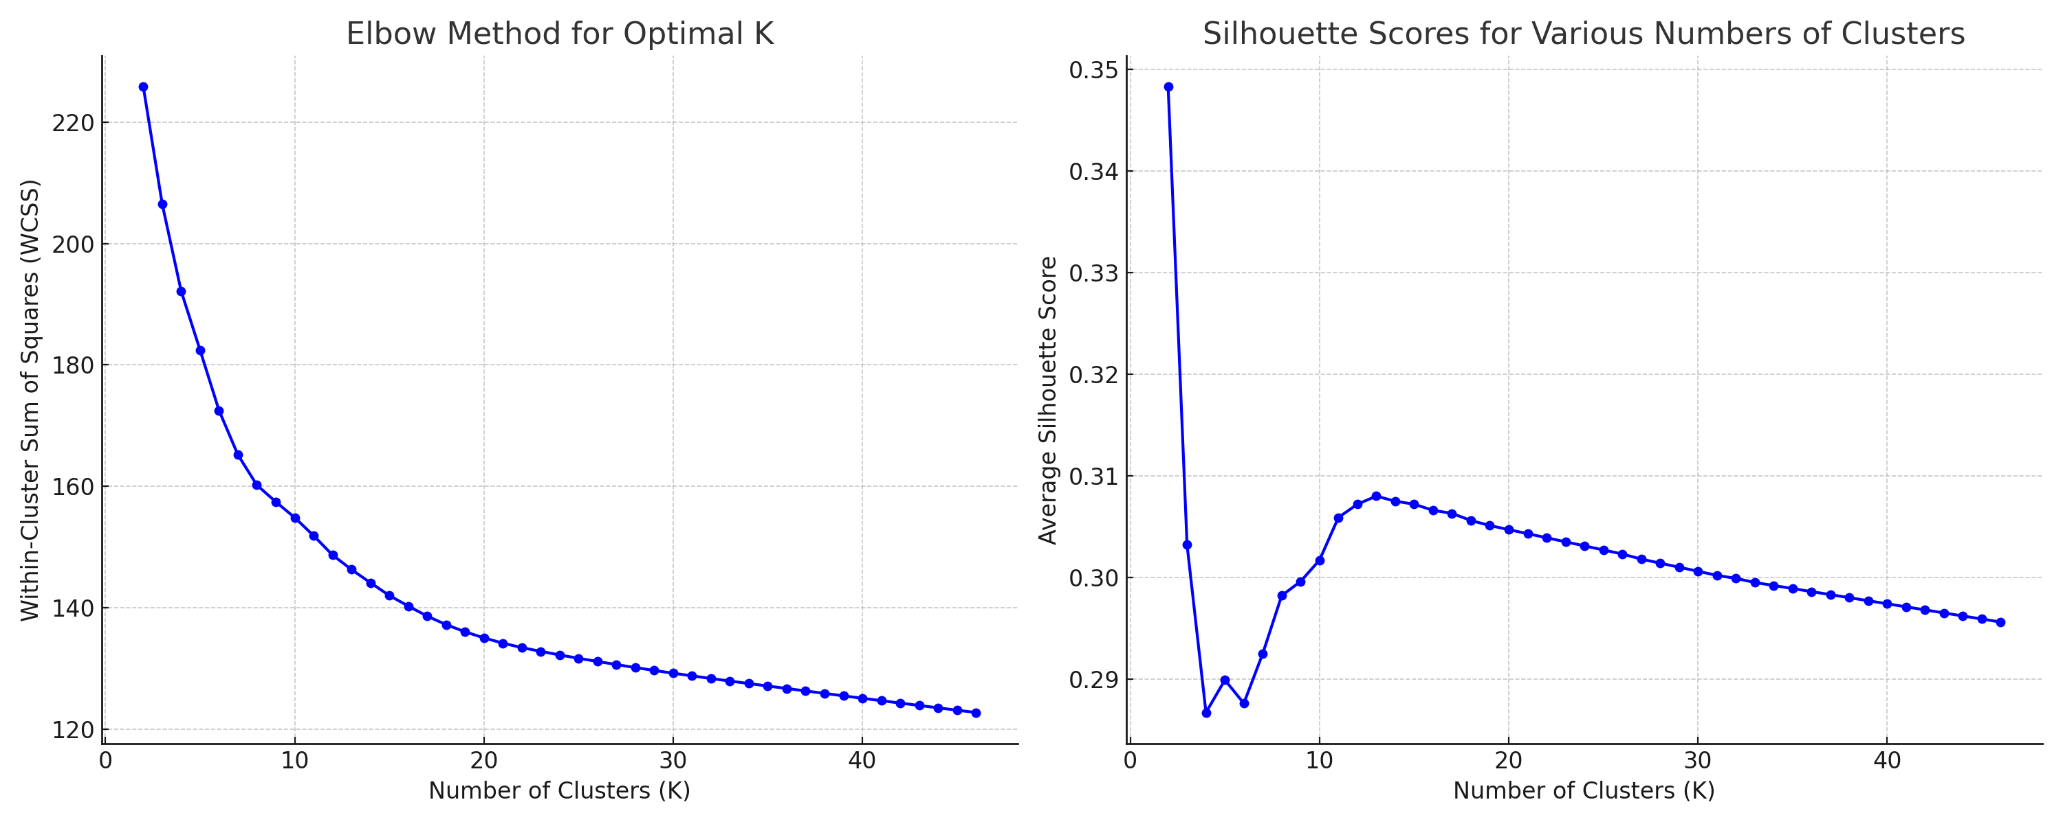
Experiments and Results Summary[2/7]
Finding number of clusters: using Elbow Method and the Silhouette Score they give result K = 14

Slide 30
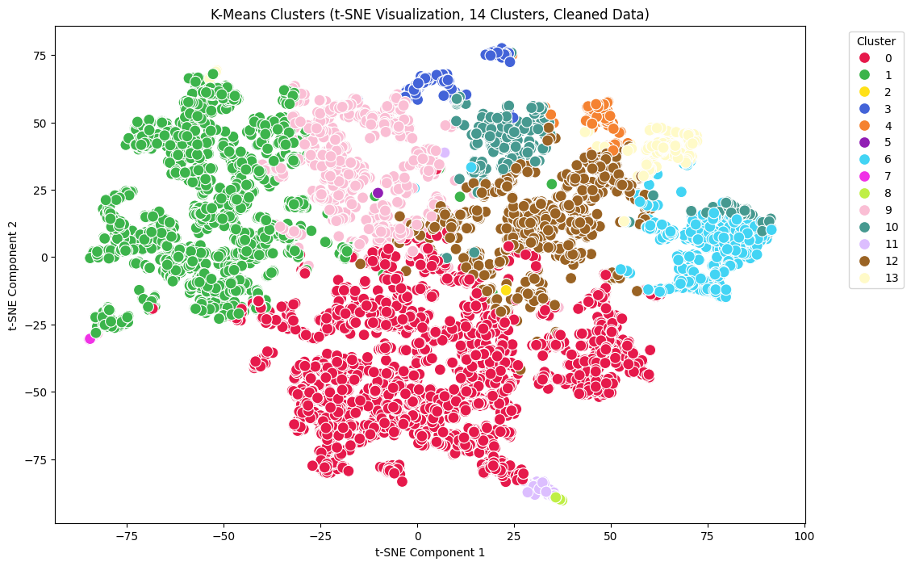
Experiments and Results Summary[3/7]
Model and Result: we use k means Clustering algorithm to make the clusters of dataset

Slide 31
Experiments and Results Summary[4/7]
2. Classification
Synthetic Dataset: we make a synthetic dataset of 20000 people using CTGAN model and split dataset 80% for training and 20% for testing.
Model training and Result: After Comparative Analysis, we selects two model Random forest and XGBoost and Ensemble them using meta learner technique for ensemble on two base models
Utilizing gradient boosting model in mete learner.

Slide 32
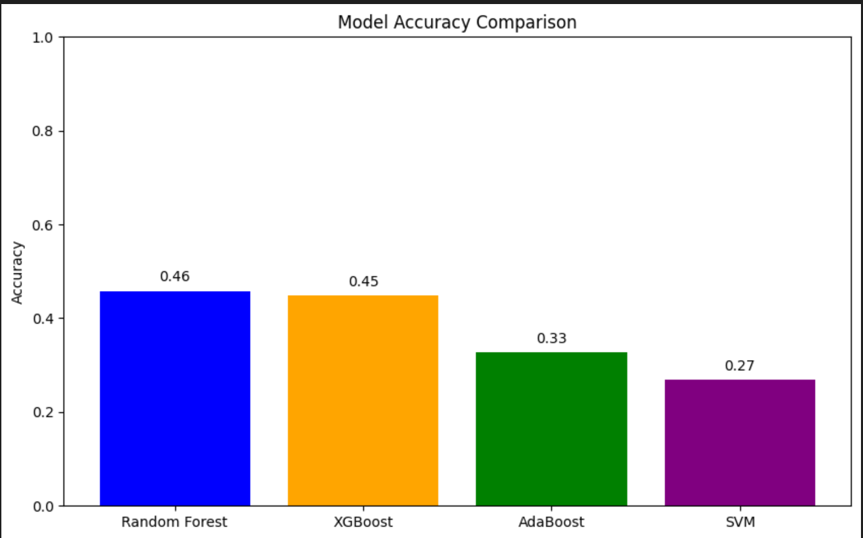
Experiments and Results Summary[5/8]
Comparative Analysis

Slide 33
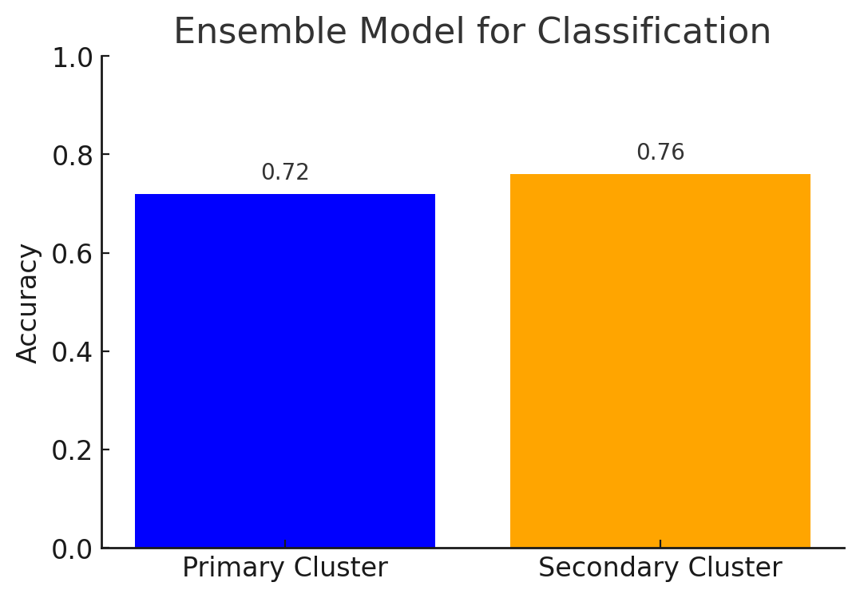
Experiments and Results Summary[5/7]
Result:

Slide 34
Experiments and Results Summary[6/7]
3. Regression
Dataset: We use food nutrition data such as protein, carbohydrates, fats and calories etc. and split dataset training 80% and testing 20%.
Model Training and Result: We use Ensemble technique to Ensemble HGB and Ridge regression model with polynomial features.

Slide 35
Experiments and Results Summary[7/7]
Result
Models | RMSE | MAE | R²
HGB | 13.80 | 7.36 | 0.993
RIDGE | 12.12 | 6.19 | 0.995
BLEND | 11.78 | 6.10 | 0.995

Slide 36
Testing Summary

Slide 37
Testing Summary
Testing Aspect | Summary
Approach | Blackbox and Whitebox
Purpose | To validate the functionalities of Fitessstan via input and output and by giving different user data.
Feature Tested | ✔ User registration & login ✔ Password recovery & OTP ✔ Input forms ✔ Diet plans ✔ Admin management ✔Model Testing
Result | ✔ All critical test cases passed successfully ✔ Correct handling of all input types ✔ Confirmed user-friendly experience

Slide 38
ENDEAVOUR

Slide 39
Endeavour[1/2]
Describe roles of your team members
Zain Ul Abideen (35515)
Web Development
Ui/Ux Design
Back End
Literature Review
Model training
Obaid Ullah (35739)
Data Collection
Model training
Research
Documentation
Huzaifa Khan (35726)
Documentation
Gap Analysis
Literature Review
Ui/Ux Design

Slide 40
Endeavour[2/2]
Describe your way of working as a team
Clear Role Assignments: Tasks are assigned based By Team Leader.
Communication:
Held regular meetings to review progress, address challenges, and plan next steps.
Leveraged tools like GitHub for version control and collaborative development.
Efficiency Focus: Optimizing processes for real-time results and smooth integration.

Slide 41


